Slide 1

Introduction to Molecular genetics
Prepared by
Dr. Rawa Abdul Redha Aziz
Ph.D Antibiotics/ Molecular biology
Dr. Hiba Shakir Ahmed
Ph.D Microbiology/Immunity

Slide 2
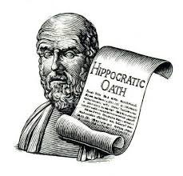
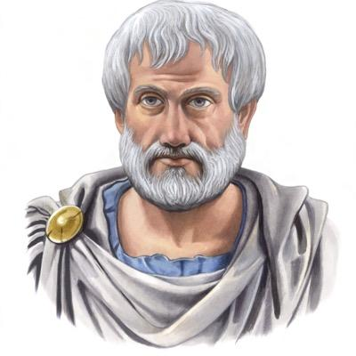
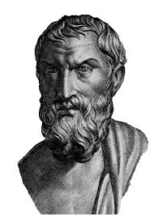
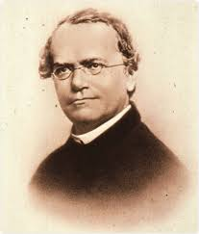
History
Genetics history dates from the classical era with contributions by Hippocrates, Aristotle and Epicurus.
Modern genetics began with the work of the Augustinian friar Gregor Johann Mendel.

Slide 3

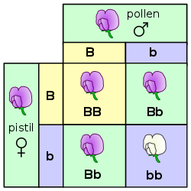
His work on pea plants, published in 1866, described what came to be known as Mendelian inheritance.
Many theories of heredity proliferated in the centuries before and for several decades after Mendel's work

Slide 4
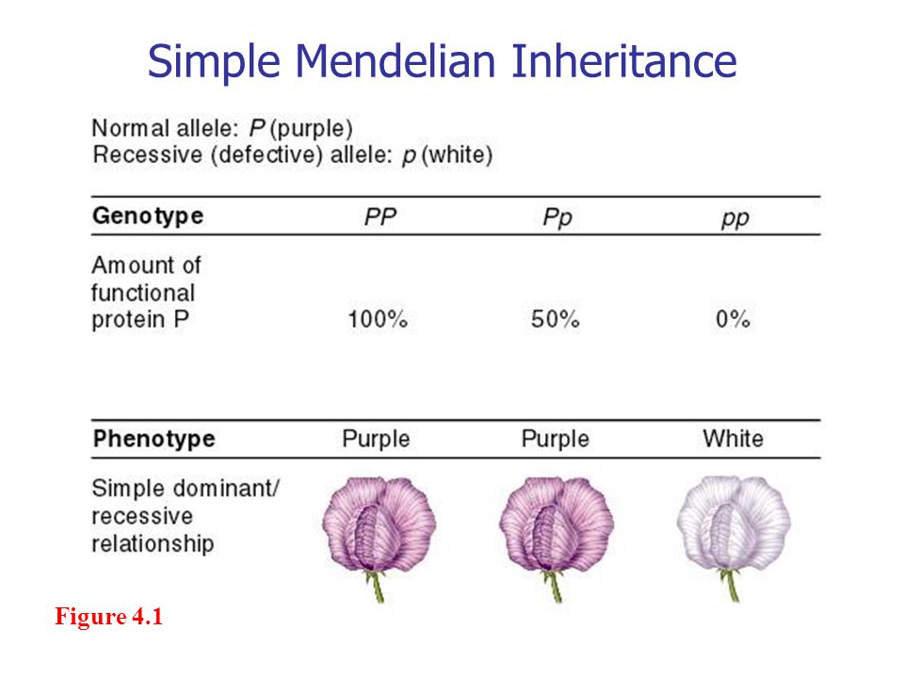

Slide 5
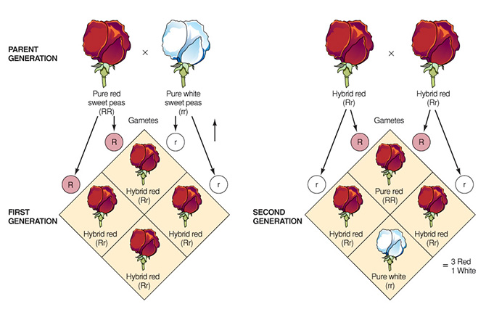

Slide 6
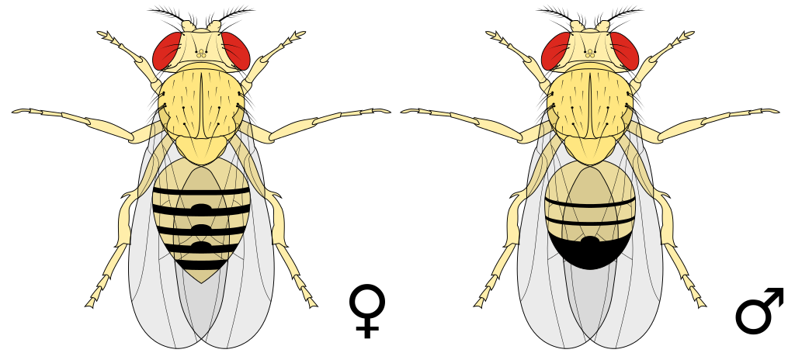
The year 1900 marked the "rediscovery of Mendel" by Hugo de Vries, Carl Correns and Erich von Tschermak, and by 1915 the basic principles of Mendelian genetics had been applied to a wide variety of organisms—most notably the fruit fly Drosophila melanogaster.

Slide 7
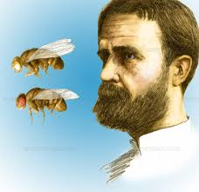
Led by Thomas Hunt Morgan and his fellow "drosophilists", geneticists developed the Mendelian model, which was widely accepted by 1925. Alongside experimental work, mathematicians developed the statistical framework of population genetics, bringing genetic explanations into the study of evolution.

Slide 8
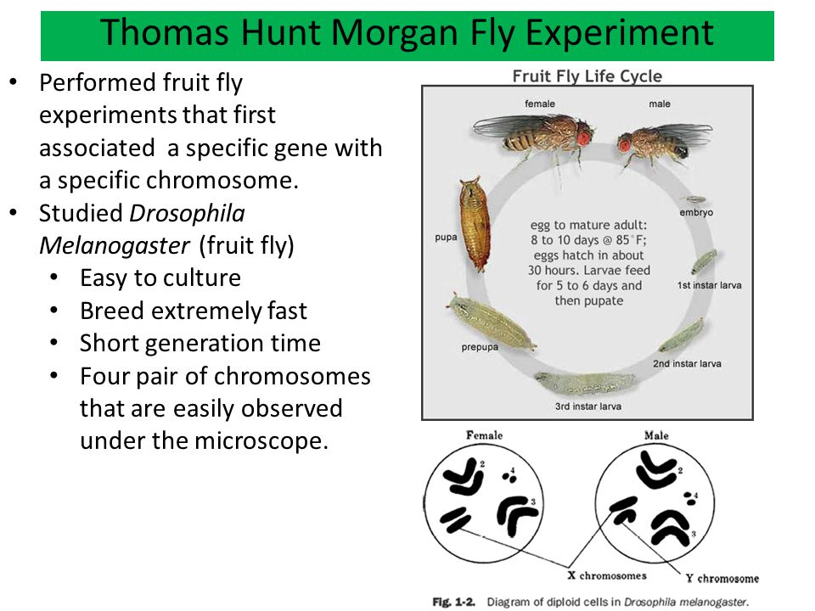

Slide 9
With the basic patterns of genetic inheritance established, many biologists turned to investigations of the physical nature of the gene.
In the 1940s and early 1950s, experiments pointed to DNA as the portion of chromosomes that held genes. A focus on new model organisms such as viruses and bacteria, along with the discovery of the double helical structure of DNA in 1953, marked the transition to the era of molecular genetics

Slide 10
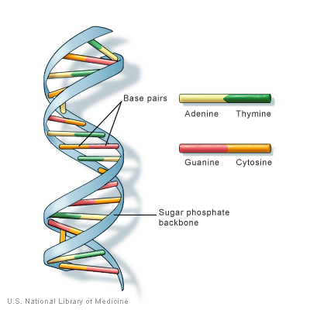
The Definition of Molecular Genetics:
It is the field of biology that studies the structure and function of genes at a molecular level and thus employs methods of both molecular biology and genetics or in other words it is the study of chromosomes and gene expression of an organism can give insight into heredity, genetic variation, and mutations.

Slide 11
Why studying Molecular Genetics?
1. Study the developmental biology.
2. Understand the relationship between the two forms of biological molecules: the genetic code
3. Gene expression could be controlled and manipulated through genetic engineering
4. Large-scale genetics projects, sequencing entire genomes and proteins.
5. Understand and treat genetic diseases.

Slide 12
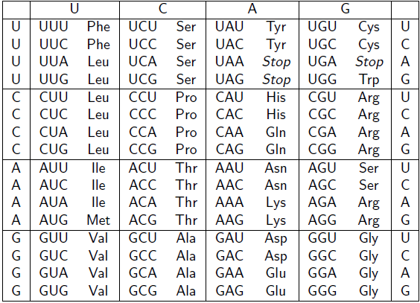
The genetic code is the set of rules by which information encoded within genetic material (DNA or mRNA sequences) is translated into proteins by living cells.

Slide 13

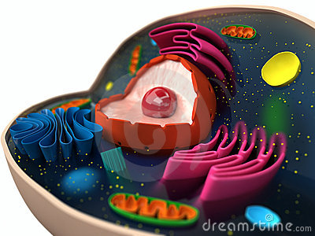
The "Cell"
It is the basic structural, functional, and biological unit of all known living organisms. A cell is the smallest unit of life that can replicate independently, and cells are often called the "building blocks of life".

Slide 14

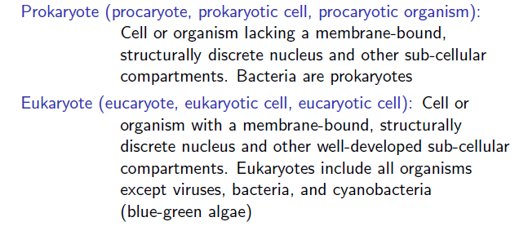
There are two kinds of cells (with and without nucleus):

Slide 15
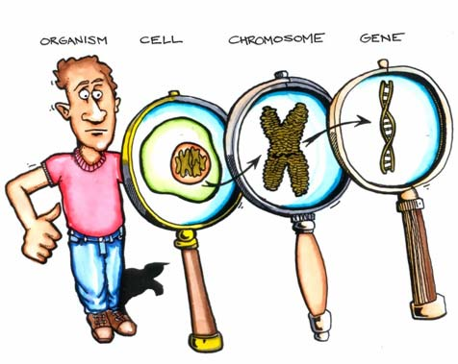

Slide 16
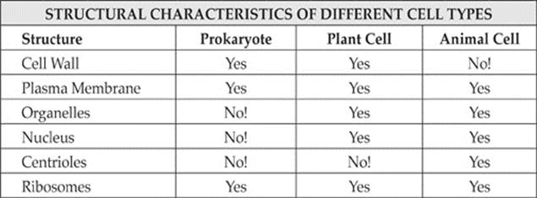

Slide 17

Any Question?

